Slide 1
MS Access
Lab 25: Create Table

Slide 2


Welcome to MS Access Class

Slide 3

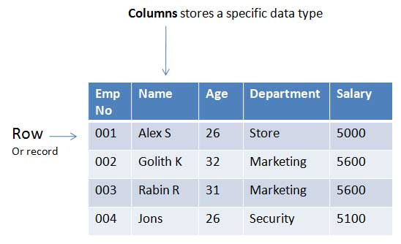
What is Table in Database?
A table is a collection of related data held in a structured format within a database. It consists of fields (columns), and rows.

Slide 4
Database
Customize The Blank Table

Slide 5
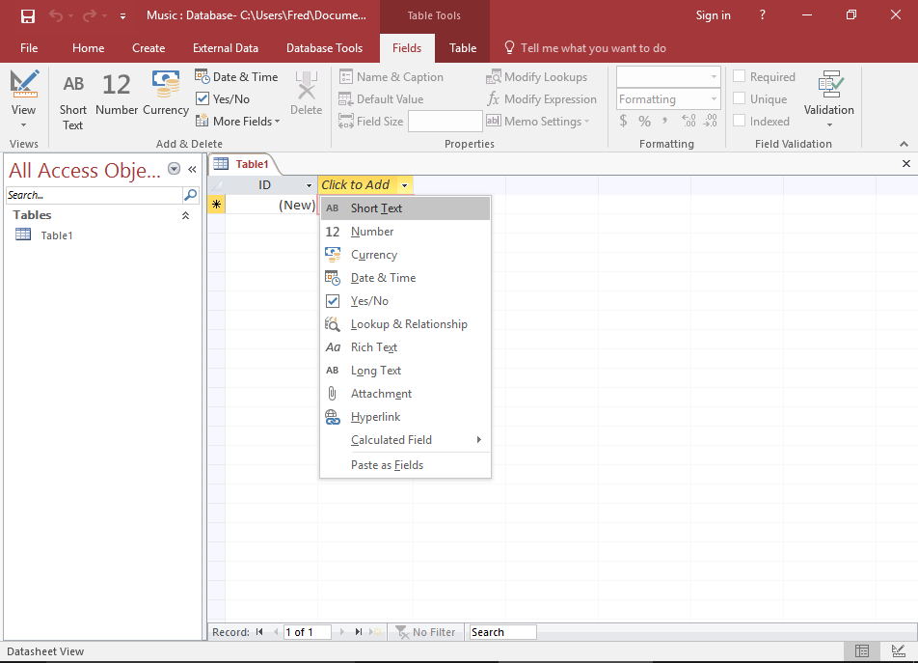
Customize Blank Table
Select a Data Type for the New Field
Right-click Click to Add and select Short Text from the combo box. This combo box lists the data types you can assign to a field.

Slide 6
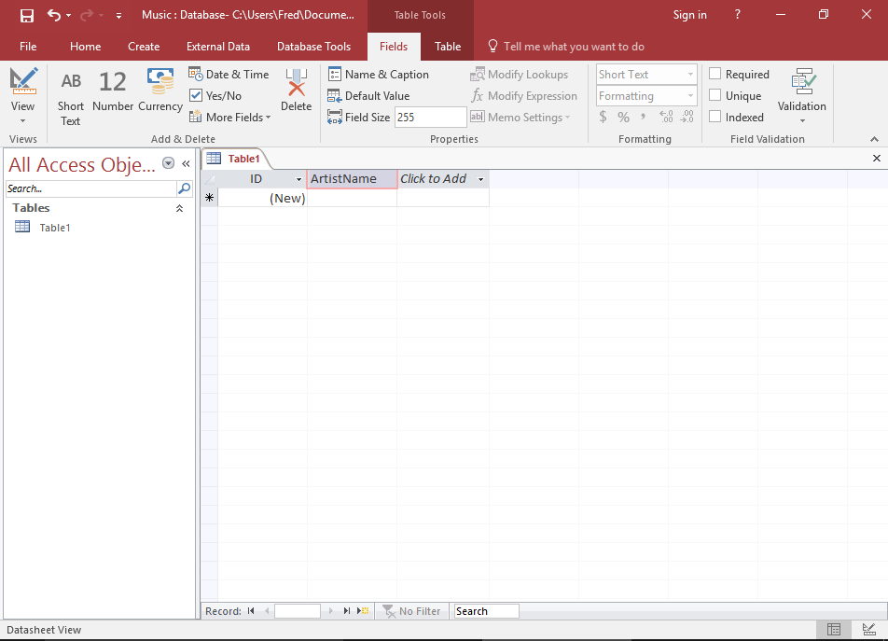
Customize Blank Table
Name The Field
Once you've selected a data type, the field header will be highlighted with the text Field1 so that you can provide a name for the field. Enter ArtistName as the name of the field. .

Slide 7
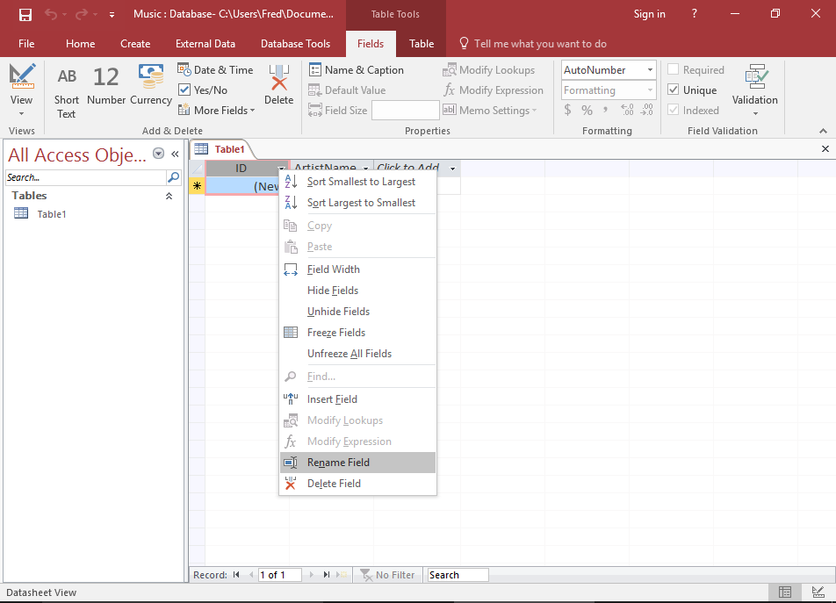
Customize Blank Table
Rename the First Field
The first field in our table is currently called ID. We'll rename it. Right-click on the ID field header, and select Rename Field. The field will be highlighted for you to rename it. Enter ArtistId.

Slide 8
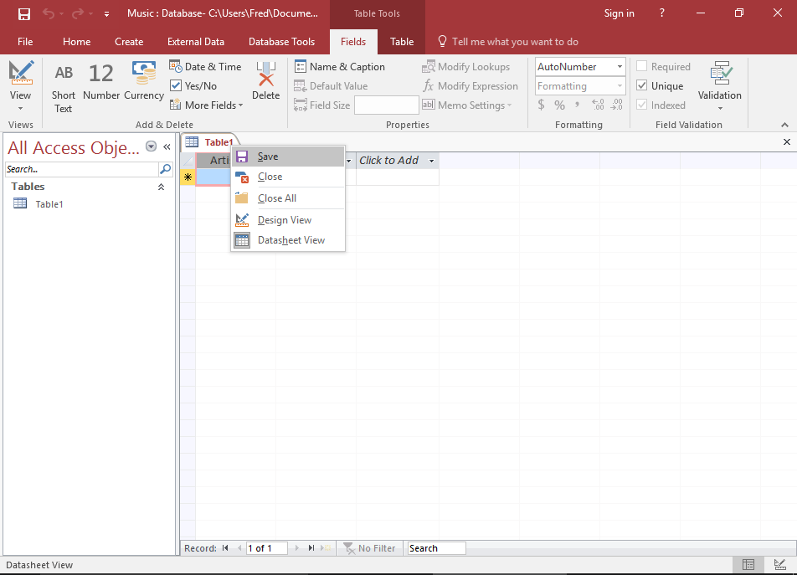
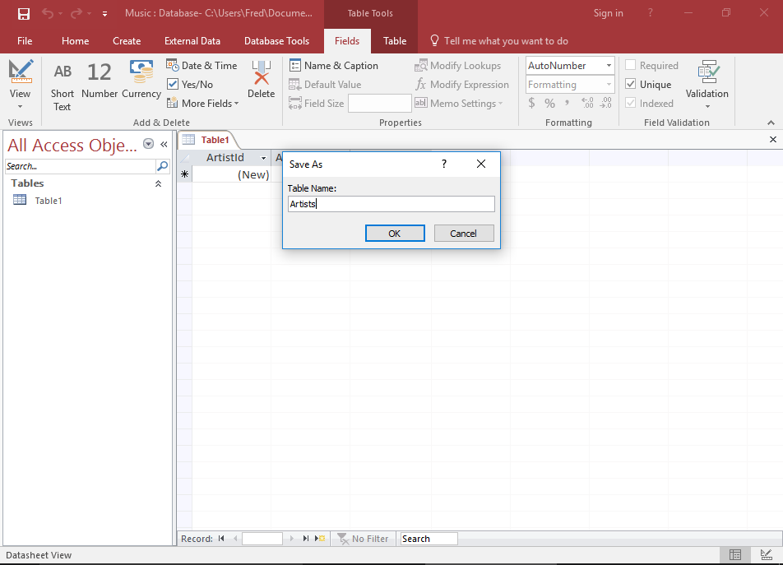
Customize Blank Table
Save the Table
Right-click on Table1 to save the table. Screenshot of entering a name at the prompt. Enter Artists at the prompt. Right-click on Table1 to save the table. Screenshot of entering a name at the prompt. Enter Artists at the prompt.

Slide 9
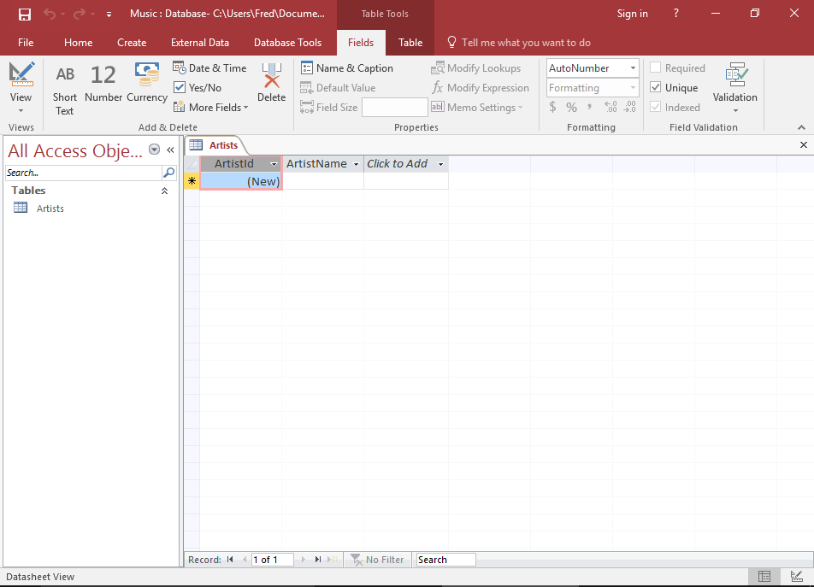
Customize Blank Table
Your Finished Table
Your database table now contains two fields (ArtistId and ArtistName)

Slide 10
Database
Create a New Table

Slide 11
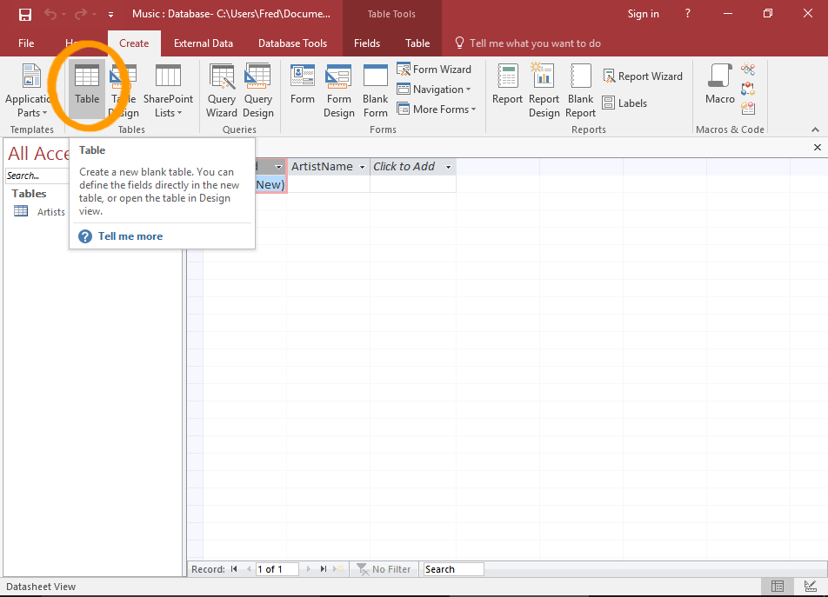
New Table
1. Select Table Option
Ensuring the Create tab is selected on the Ribbon, click Table. This will add a blank table called Table1 to the database.

Slide 12
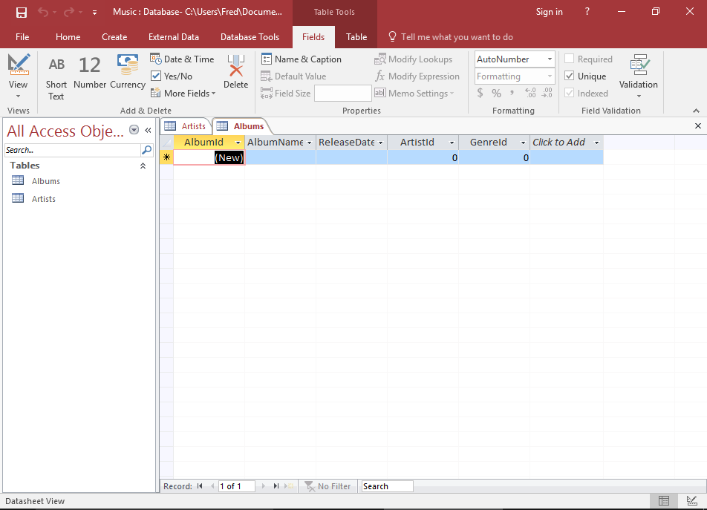
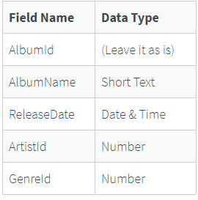
New Table
2. Set up the Fields
Now add 4 fields and rename the first. Set them up as follows:

Slide 13

Thank You!

